Slide 1
Transient Simulation of Detrap Failure under Retention Operation of BETOX 3D NAND Flash Cell 진명

Slide 2
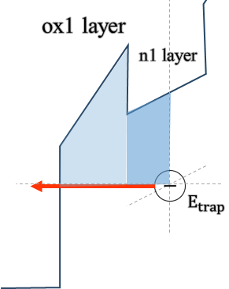
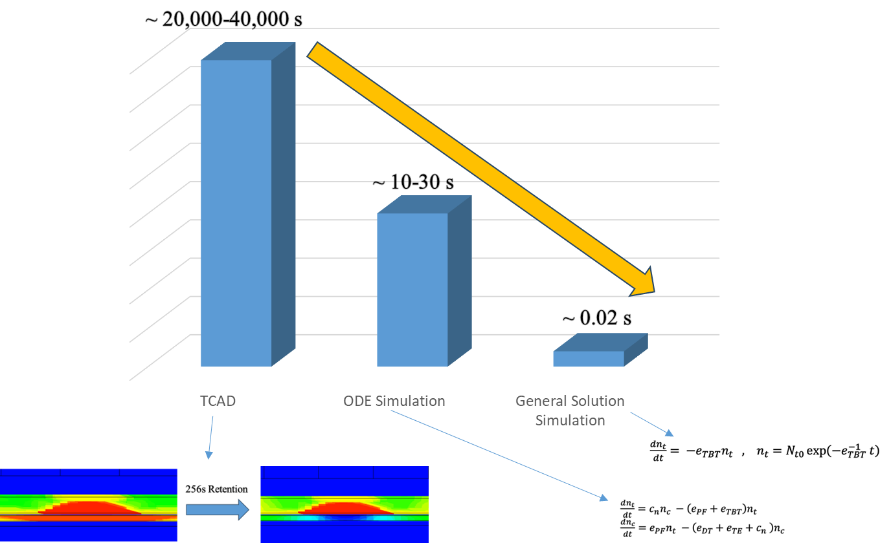
Research Flow
Single level trap profile fit
TBT Emission model
0.6 eV Elastic
0.8 eV Elastic
1.5 eV Elastic
②
①
Gaussian distribution trap profile fit
Simulation time reduction
μ = 0.85 [eV], σ = 0.25 [eV]

Slide 3
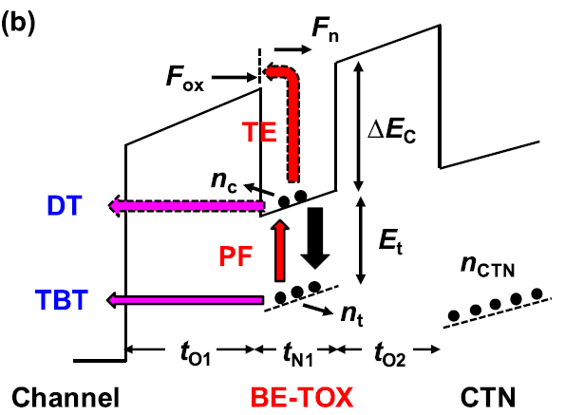
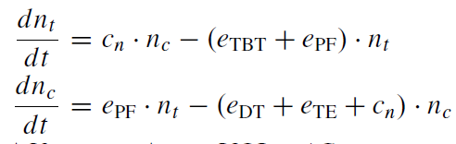
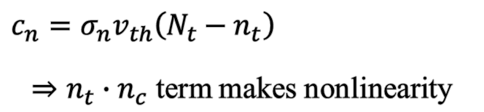
Previous Studies
김민수 박사 Detrap 논문 내용
$c_{n}=σ_{n}v_{th}\left(N_{t}−n_{t}\right)$
$⇒n_{t}∙n_{c}$ term makes nonlinearity
Single level trap profile
Poole-Frenkel Emission
Non-linear differential equation

Slide 4
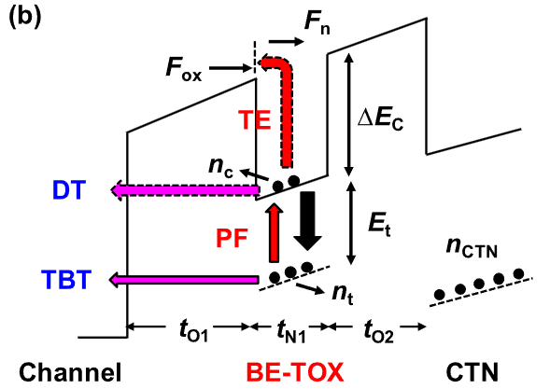
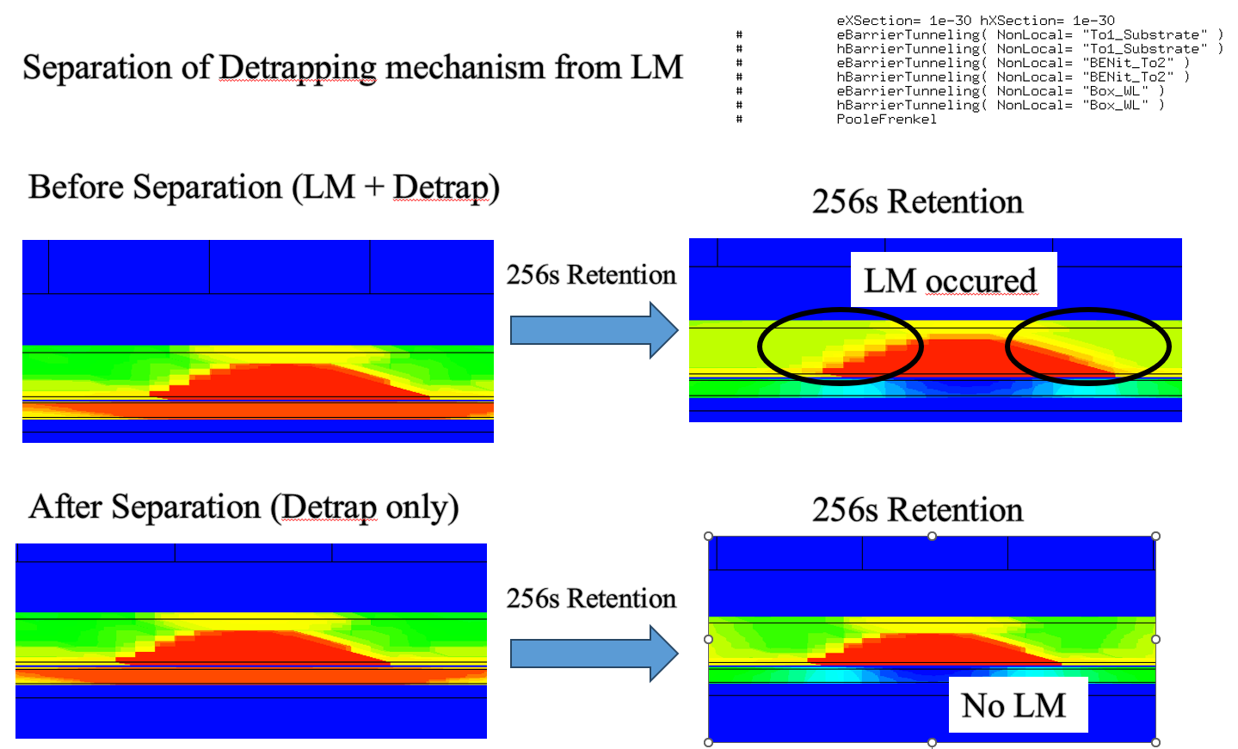
Freezing CTN (TCAD Know-how)
By minimizing capture cross section
(⸪ Poole-Frenkel emission ~ σ_{n} )
σ_{n} : 10⁻¹⁵ [cm²] → 10⁻³⁰ [cm²]
: Result of CTN LM turn-on/off

Slide 5
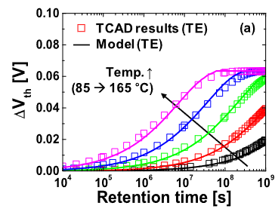


Simplifying the Detrap Model
Thermal emission negligible
Large time constant
Result…
Only TBT is left
Vertical direct tunneling negligible
BETOX Nitride Region
$\frac{dn_{t}}{dt}=−e_{TBT}n_{t}$
$n_{t}=N_{t0}\exp\left(−e_{TBT} t\right)$
… $τ_{TBT}=e_{TBT}^{−1}$
$e_{TBT}=ν_{TBT}×TC$
Rather than direct tunneling,
lateral directional spreading may occur
High Vertical Electrical Field

Slide 6

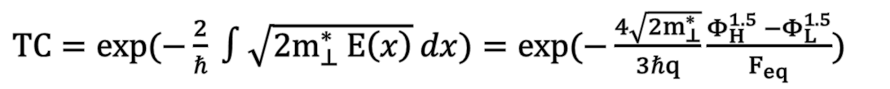
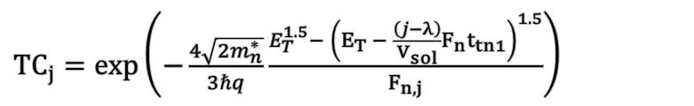


Tunneling through Trapezoidal Barrier (TC)
: WKB approximation under uniform field trapezodidal barrier
$Φ_{L}$
$Φ_{H}$
$TC=\exp{(−\frac{2}{ℏ} ∫\sqrt{2m_{⊥}^{∗} E\left(x\right)} dx)}=\exp{(−\frac{4\sqrt{2m_{⊥}^{∗}}}{3ℏq}\frac{Φ_{H}^{1.5} −Φ_{L}^{1.5}}{F_{eq}})}$
Φ_{H}, Φ_{L}, F_{eq} dependent
Double Barrier Emission: Simple Multiplication ( TC_{total} = ① x ② )
${TC}_{j}=\exp\left(−\frac{4\sqrt{2m_{n}^{∗}}}{3ℏq}\frac{E_{T}^{1.5}− {\left(E_{T} − \frac{\left(j−λ\right)}{V_{sol}}F_{n}t_{tn1}\right)}^{1.5}}{F_{n, j}}\right)$
①
②
①
$× \exp\left(−\frac{4\sqrt{2m_{ox}^{∗}}}{3ℏq}\frac{{\left(E_{T}+ΔE_{c}− \frac{\left(j−λ\right)}{V_{sol}}F_{n}t_{tn1}\right)}^{1.5}− {\left(E_{T}+ΔE_{c}− \frac{\left(j−λ\right)}{V_{sol}}∙F_{n}t_{tn1}−F_{ox}t_{tox1}\right)}^{1.5}}{F_{ox}}\right)$
②

Slide 7



Tunneling through Trapezoidal Barrier (TC)
Uniform Field Assumption
BE-TOX (ONO)
$$ΔF_{ox}$$
CTN
ox1 layer
ox2 layer
$$F_{ox}$$
n1 layer
Electric Field
$\frac{ΔF_{ox}}{F_{ox}}<8\%$
Low field intensity difference (< 8%) … reference field set to centroid

Slide 8
Trap-to-Band Tunneling Current Modeling (ν_{TBT})
Trap-interface coupling
Region 1 as carrier reservoir
Fermi statistics follows Region 1: E_{F,r}
Tunneling capture-emission statistics
Follows “Principle of Detailed Balance”
Region 2
Region 1
(reservoir)
E_{C}
E_{trap}
E_{C,r}
Tunneling
Capture-Emission
Statistics
SRH
Statistics
E_{F,r}
E_{V,r}
E_{V}
Trap-interface coupling

Slide 9

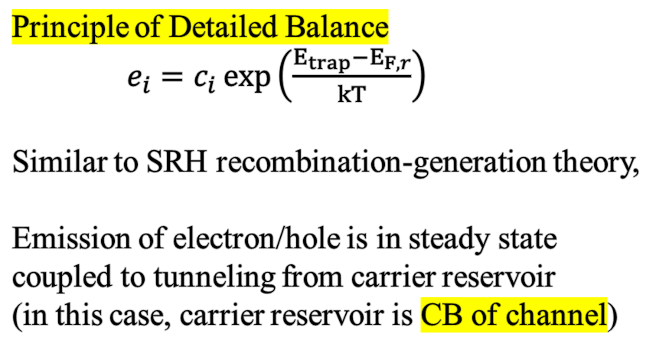



Trap-to-Band Tunneling Current Modeling (ν_{TBT})
BE-TOX (ONO)
Principle of Detailed Balance
$e_{i}=c_{i}\exp\left(\frac{E_{trap}−E_{F,r}}{kT}\right)$
Similar to SRH recombination-generation theory,
Emission of electron/hole is in steady state coupled to tunneling from carrier reservoir
(in this case, carrier reservoir is CB of channel)
CTN
ox1 layer
ox2 layer
n1 layer
$e_{n, elastic}$
$c_{n, elastic}$
$E_{Fi}$
$c_{n, elastic}=D\left(E_{trap}\right)∙W_{transition}∙f_{c}\left(E_{trap}\right)∙\left|TC\right|$
$e_{n, elastic}=c_{n, elastic}\exp\left(\frac{E_{trap}−E_{F,r}}{kT}\right)$

Slide 10




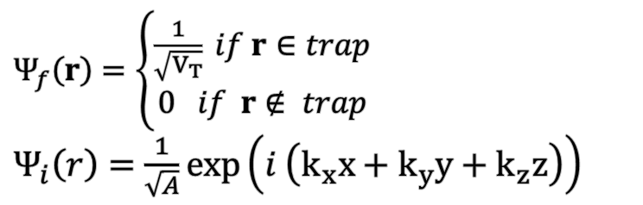
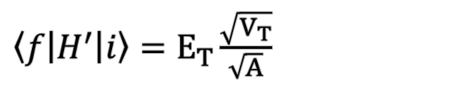
Trap-to-Band Tunneling Current Modeling (ν_{TBT})
$c_{n, elastic}=D\left(E_{trap}\right)∙W_{transition}∙f_{c}\left(E_{trap}\right)∙\left|TC\right|$
$W_{transition}=\frac{2π}{ℏ} {\left|\left\langle f | H^{′} | i\right\rangle \right|}^{2} δ\left(E−E_{T}\right)$ : Transition rate by Fermi golden rule
$H^{′}= \left\{\begin{aligned}0 \\ −E_{T}\end{aligned} \right.$ : Constant perturbation of energy band by trap
$$\iiint_{V_{T}}{{\left|Ψ_{f}\right|}^{2} dxdydz}=1$$
$Ψ_{f}\left(r\right)=\left\{\begin{aligned}\frac{1}{\sqrt{V_{T}}} if r∈trap \\ 0 if r∉ trap\end{aligned}\right.$
$Ψ_{i}\left(r\right)=\frac{1}{\sqrt{A}}\exp\left(i \left(k_{x}x+k_{y}y+k_{z}z\right)\right)$
Constant Trap
$\left(H_{B}+H^{′}\right)ψ=E_{c} ψ$ : Unperturbed energy band free electron
$E_{c}$
$E_{t}$
Free wave eq.
$\left\langle f | H^{′} | i\right\rangle =E_{T}\frac{\sqrt{V_{T}}}{\sqrt{A}}$
$\left(H_{B}+H^{′}\right)ψ=\left(E_{c}−E_{t}\right)ψ$ : Trapped electron
$W_{transition}=\frac{2π}{ℏ} V_{T} E_{T}^{2} δ\left(E−E_{T}\right)$

Slide 11
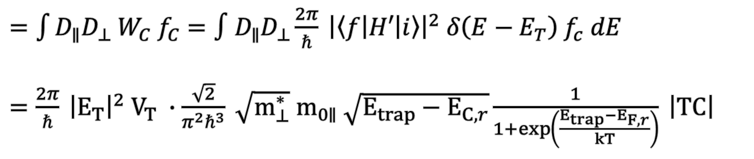
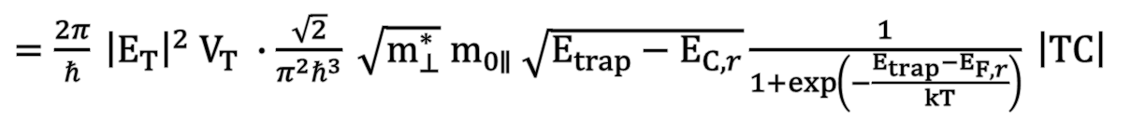
Trap-to-Band Tunneling Current Modeling (ν_{TBT})
$c_{n, elastic}=D\left(E_{trap}\right)∙W_{transition}∙f_{c}\left(E_{trap}\right)∙\left|TC\right|$
$=\int{D_{∥}D_{⊥} W_{C} f_{C}}=∫D_{∥}D_{⊥}\frac{2π}{ℏ} {\left|\left\langle f | H′ | i\right\rangle \right|}^{2} δ\left(E−E_{T}\right) f_{c} dE$
$=\frac{2π}{ℏ} {\left|E_{T}\right|}^{2} V_{T} ∙\frac{\sqrt{2}}{π^{2}ℏ^{3}} \sqrt{m_{⊥}^{∗}} m_{0∥} \sqrt{E_{trap}−E_{C,r}}\frac{1}{1+\exp\left(\frac{E_{trap}−E_{F,r}}{kT}\right)} \left|TC\right|$
$e_{n, elastic}=c_{n, elastic}\exp\left(\frac{E_{trap}−E_{F,r}}{kT}\right)$
$=\frac{2π}{ℏ} {\left|E_{T}\right|}^{2} V_{T} ∙\frac{\sqrt{2}}{π^{2}ℏ^{3}} \sqrt{m_{⊥}^{∗}} m_{0∥} \sqrt{E_{trap}−E_{C,r}}\frac{1}{1+\exp\left(−\frac{E_{trap}−E_{F,r}}{kT}\right)} \left|TC\right|$

Slide 12


Trap-to-Band Tunneling Current Modeling (ν_{TBT})
$e_{n, elastic}=\frac{2π}{ℏ} {\left|E_{T}\right|}^{2} V_{T} ∙\frac{\sqrt{2}}{π^{2}ℏ^{3}} \sqrt{m_{⊥}^{∗}} m_{0∥} \sqrt{E_{trap}−E_{C,r}}\frac{1}{1+\exp\left(−\frac{E_{trap}−E_{F,r}}{kT}\right)} \left|TC\right|$
$=ν_{TBT} \left|TC\right| , ν_{TBT}≈4×{10}^{10} \left[s^{−1}\right]$ (at E_{t} = 0.8eV single level)
Additional information
V_{T} = 10⁻³³ [m³] = (0.1Å)³ = (λ_{e})³ : ideally trapped electron (λ_{e} : electron matter wavelength)
E_{trap} : Energy level of trapped electron
|E_{T}| : Energy level difference from conduction band
~0.1Å
$$λ_{e}$$
E_{C}
|E_{T}|
E_{trap}
(reservoir)
E_{C,r}
E_{trap} – E_{C,r}
E_{F,r}
E_{V,r}
E_{V}

Slide 13




Simulation Method
BE-TOX (ONO)
BE-TOX
CTN
ox1 layer
ox2 layer
coordinate
n1 layer
$e_{n, elastic}$
Energy Band
$c_{n, elastic}$
$E_{trap}$
F_{n, j}
TC_{j}
… e_{TBT, j} = ν_{TBT} x TC_{j}
$E_{Fi}$
“Centered balance point”
λ used as a fitting parameter
(0< λ<1)
e_{TBT, j}
_{(for all j segments)}
F_{ox}
(r_{tox},center)
Φ_{L}
Φ_{H}
1-λ
λ

Slide 14
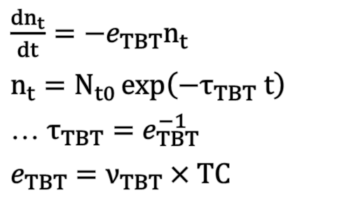
Simulation Method
$\frac{dn_{t}}{dt}=−e_{TBT}n_{t}$
$n_{t}=N_{t0}\exp\left(−τ_{TBT} t\right)$
… $τ_{TBT}=e_{TBT}^{−1}$
$e_{TBT}=ν_{TBT}×TC$
n segments
More segments,
More precise result

Slide 15
Final Result of Retention Transient
Single level trap profile fit
Gaussian distribution trap profile fit
Can be adopted to various
trap profile & PV levels!

Slide 16

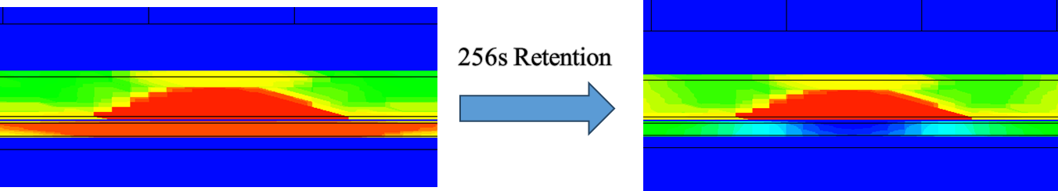
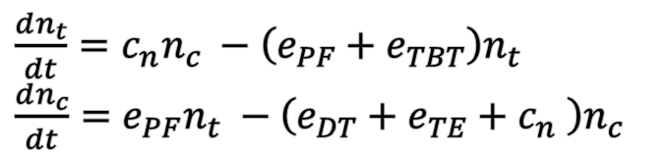
Simulation Time Reduction
Simulation Time Reduction
~ 20,000-40,000 s
Time Reduction
ODE Simulation
→ operation oriented
~ 10-30 s
General Solution
Simulation
→ no ODE Solving
~ 0.02 s

